Slide 1

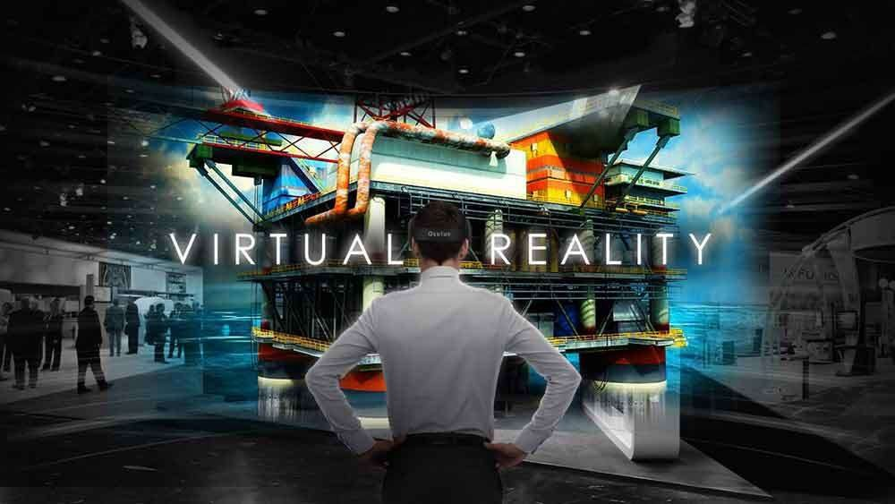
1

Slide 2

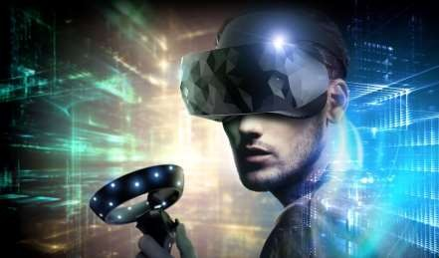
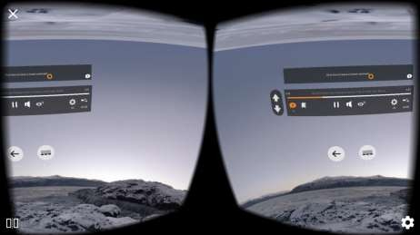
VIRTUAL REALITY
Real-time interactive graphics with three-dimensional models, combined with a display technology that gives the user the immersion in the model world and direct manipulation.

Slide 3
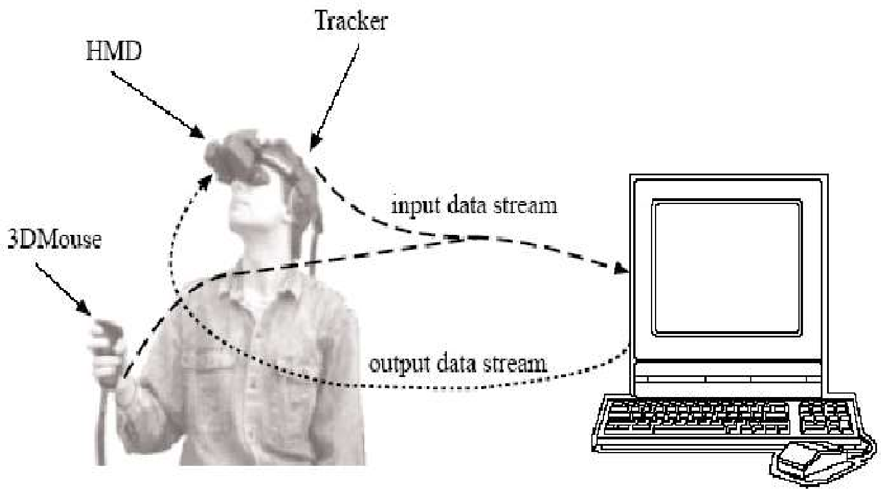

Slide 4


TYPES OF VR SYSTEM
VR systems can be classified into 3 major categories based on one of the important features of VR, which is immersion and the type of interfaces or components utilized in the system. These are:
Non-immersive
Immersive
Semi-immersive

Slide 5




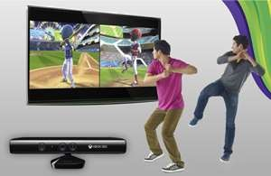
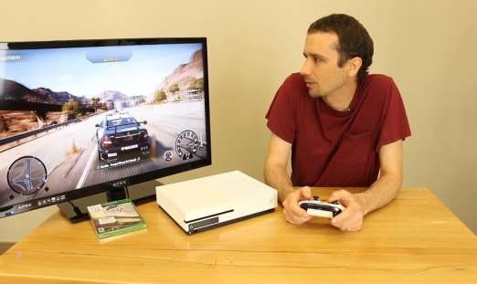
NON-IMMERSIVE VR SYSTEM
Also called Desktop VR system, Fish tank or Window on World system
Least immersive and least expensive of the VR systems, as it requires the least sophisticated components.
It allows users to interact with a 3D environment through a stereo display monitor and glasses

Slide 6


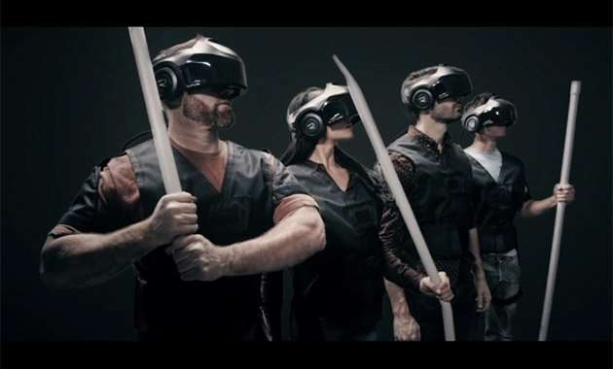
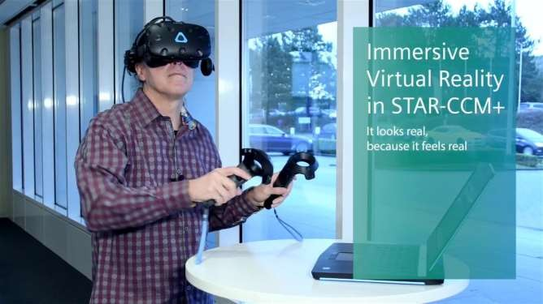
IMMERSIVE VR SYSTEM
Most expensive and gives the highest level of immersion
Its components include HMD, tracking devices, data gloves and others, which encompass the user with computer generated 3D animation that give the user the feeling of being part of the virtual environment.

Slide 7



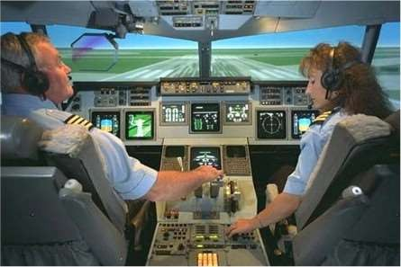
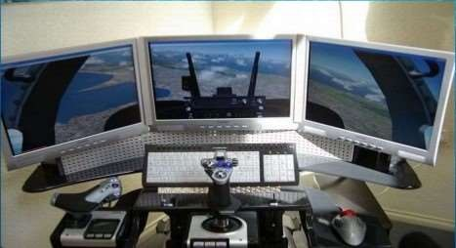
SEMI-IMMERSIVE VR SYSTEM
Provides high level of immersion, while keeping the simplicity of the desktop VR or utilizing some physical model.
Example of such system includes the CAVE (Cave Automatic Virtual Environment) and an application is the driving simulator

Slide 8


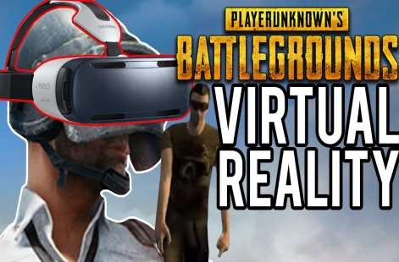
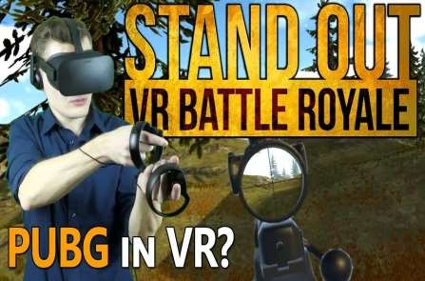
DISTRIBUTED VR SYSTEM
New category of VR system, which exists as a result of rapid development of internet.
Its goal is to remove the problem of distance, allowing people from many different locations to participate and interact in the same virtual world through the help of the internet and other networks.

Slide 9
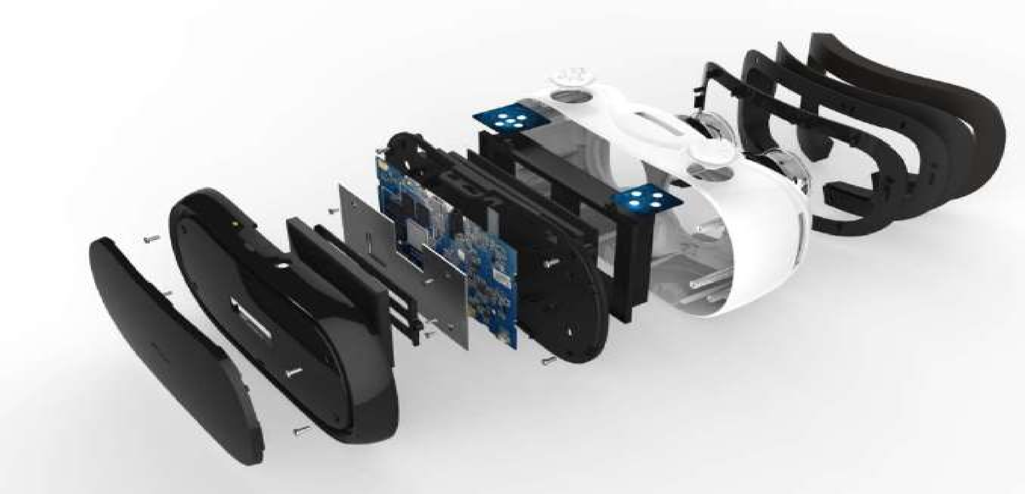
KEY COMPONENTS
10

Slide 10

SENSORS
Magnetometer:
Measures magnetic fields.
Essentially acts as a compass, and by being able to detect magnetic North, it can always tell which direction it is
facing
Accelerometer:
Used to let your device know which way it is facing.
Measures acceleration across an axis or multiple axes
Detect position, velocity, vibration, and to determine orientation
Gyroscope:
Used for measuring and maintaining orientation and angular velocity.
A gyroscope senses changes in twist and angle.
11

Slide 11

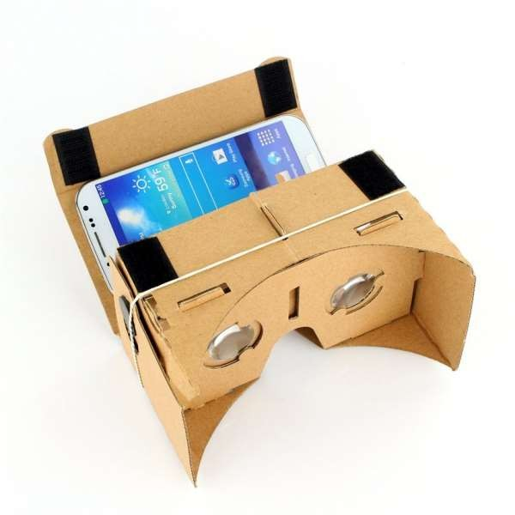
LENSES
Lenses in our eyes is to alter the incoming light in a way that it gets focused on our receptors on the back of our eyes.
If you look at something really close your lenses have to bend a lot to give you a sharp image.
In Virtual Reality, Head Mounted Displays (VR HMDs) are 3 to 7 cm in front of our eyes. That’s why we
need lenses in VR HMDs that bend the light and make it easier for our eyes to see.
Google Cardboard
12

Slide 12
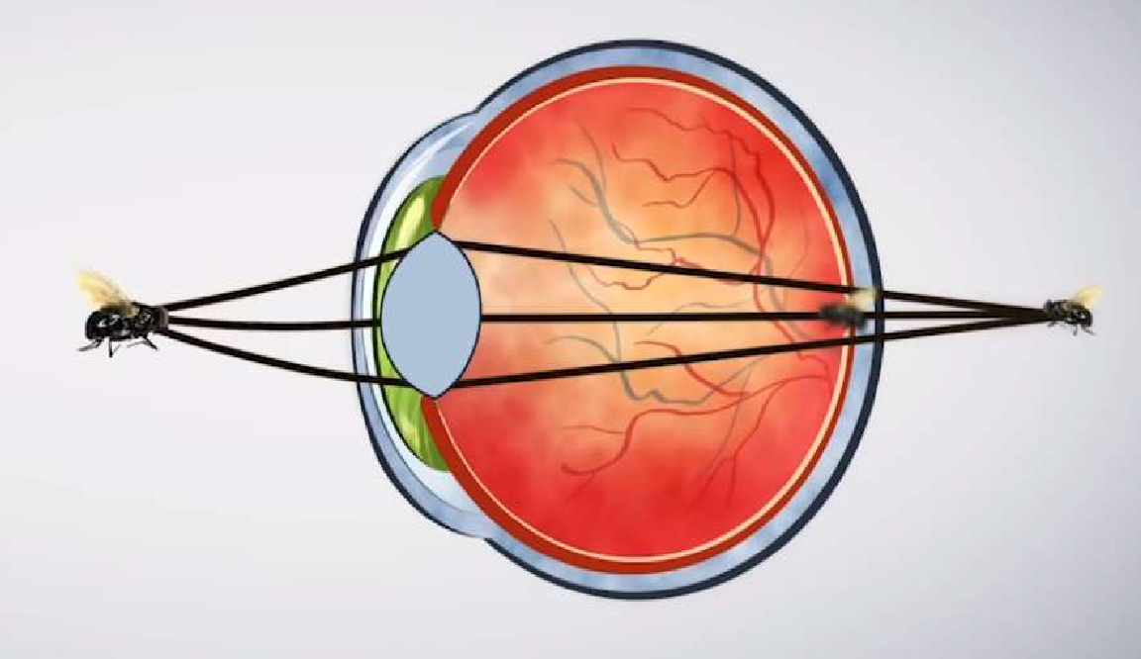
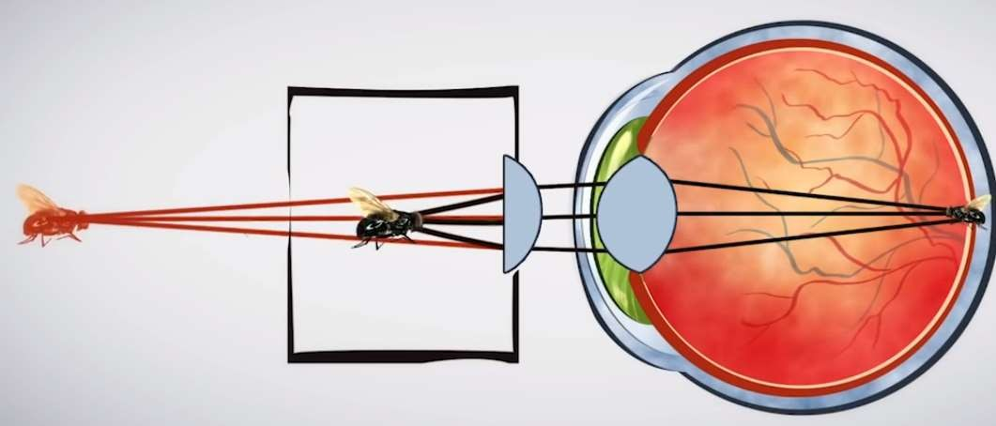
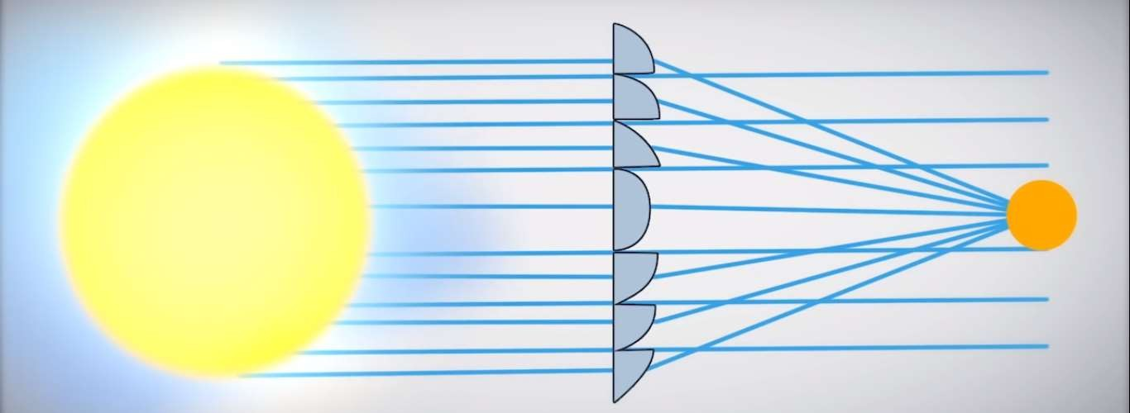
Fresnel Lenses used in many VR Headsets
13

Slide 13




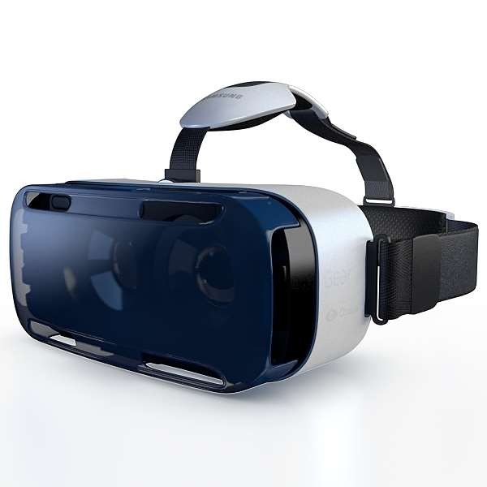
DISPLAY SCREEN
PC/Console/Smartphones:
Computers are used to process inputs and outputs sequentially. To power the content creation and production significant computing power is required, thereby making PC/consoles/smartphones important part of VR systems
Head Mount Display(HMD):
It is a display device, worn on the head or as part of a helmet, that has a small display optic in front of one (monocular HMD) or each eye (binocular HMD).
A HMD has many uses, including in gaming, aviation, engineering, and medicine lift.
A typical HMD has one or two small displays, with lenses and
semi-transparent mirrors embedded in eyeglasses
Have their own screen
14

Slide 14
Input Devices:
Provides users the sense of immersion and determines the way a user communicates with the computer.
Helps users to navigate and interact within a VR environment to make it intuitive and natural as possible
Examples: Joysticks, force Balls/Tracking balls, Controller wands, Data gloves, trackpads, On-device control buttons, Motion trackers, Bodysuits, Treadmills and Motion platforms.
VR Engine:
Responsible for calculating and generating graphical models, object rendering, lighting, mapping, texturing, simulation and display in real-time.
Handles the interaction with users and serves as an interface with the I/O devices.
Output Devices:
Used for presenting the VR content or environment to the users
The output devices get feedback from the VR engine and pass it on to the users through the corresponding output devices to stimulate the senses.

Slide 15

SIMULATION & RENDERING
Simulation:
Usage of a computer for the imitation of a real-world process or system.
Handles interactions, object behaviors, simulations of physical laws and determines the world status
A discrete process that is iterated once for each frame
A simulation requires a model, or a mathematical description of the real system. This is in the form of computer programs, which encompass the key characteristics or behaviors of the selected system.
Here, the model is basically a representation of the system and the simulation process is known to
depict the operation of the system in time.
16

Slide 16
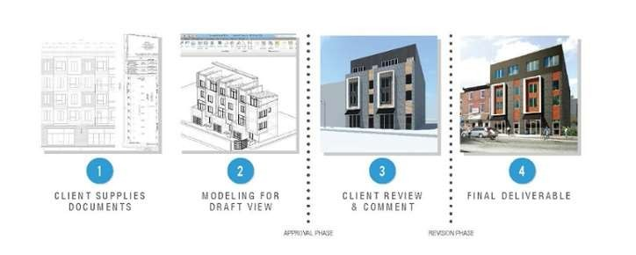
SIMULATION & RENDERING
Rendering:
Automatic process of generating a photorealistic or non-photorealistic image from a 2D or 3D model.
Particular view of a 3D model that has been converted into a realistic image.
Mostly used in architectural designs, video games, and animated movies, simulators, TV special effects and
design visualization.
17

Slide 17
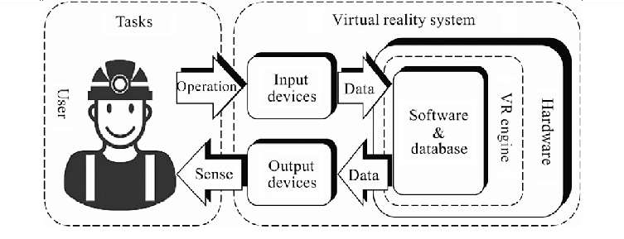
VR COMPONENT SYSTEM ARCHITECTURE
•
18

Slide 18

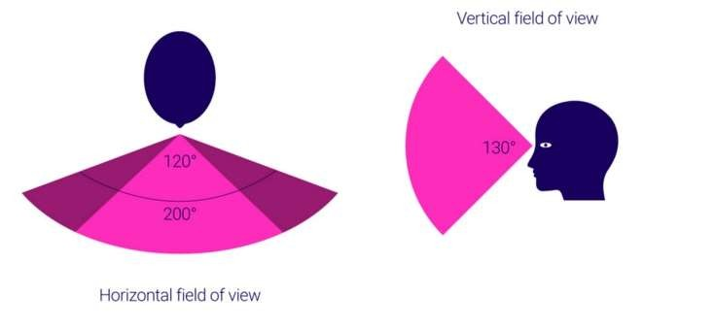
FACTORS IN VIRTUAL REALITY
Field of View(FOV)
It is defined as the total angular size of the image visible to both the eyes.
FOV describes the angle through which the devices can pick up electromagnetic radiation.
FOV allows for coverage of an area rather than a single focused point.
A large FOV is essential to getting an immersive life-like experience.
Wider FOV also provides better sensor
coverage or accessibility for many other optical devices
19

Slide 19

FACTORS IN VR SYSTEMS
Frame Rate
Number of frames or images that are projected or displayed per second.
Greatly impacts the style and viewing experience of a video.
Different frame rates yield different viewing experiences, and choosing a frame rate often means choosing between things such as how realistic you want your video to look.
Frame rates are often measured in frames per second.(fps)
To give the impression of a dynamic picture, the system updates the display very frequently with a new image
Real time, >25 frames/s → So the environment is smooth
20

Slide 20



FACTORS IN VR SYSTEM
Latency:
Latency is the amount of time a message takes to traverse a system.
Latency or lag is the delay induced by the various components of a VR system between the user’s inputs and the corresponding response from the system in the form of a change in the display.
As latency increases a user’s senses become increasingly confused as their actions become more and more delayed
Chronic cases can result in simulator sickness, hence latency must be kept to a minimum.
Latency < 50 ms
21

Slide 21

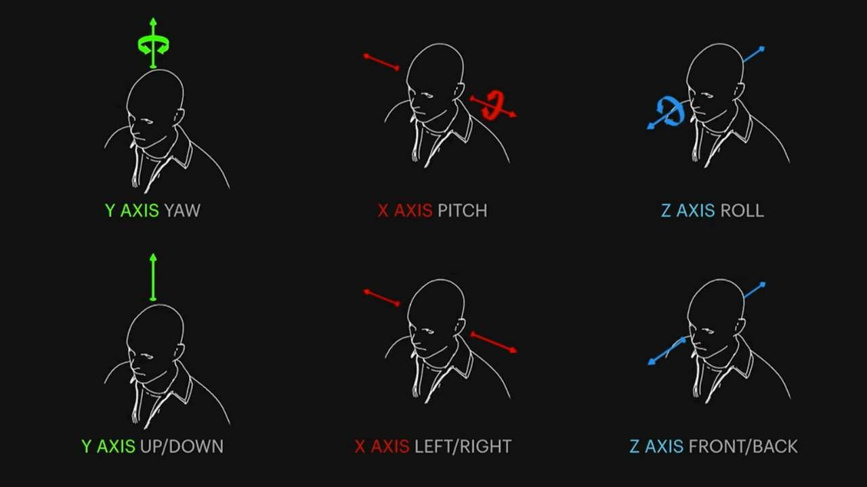



3D POSITION TRACKERS
IMU(Inertial Measurement Unit)
It is device and
an electronic that measures reports a
body's specific, angular
rate, and sometimes the magnetic field surroundings the body, using a combination of accelerometers and gyroscope, sometimes also magnetometers.
6-DEGREES OF FREEDOM(DOF)
22

Slide 22

23

Slide 23

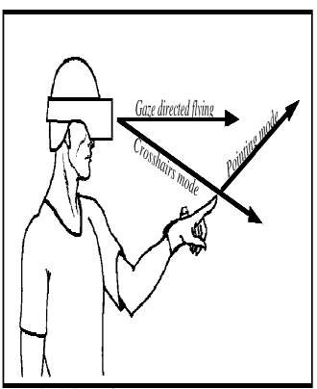
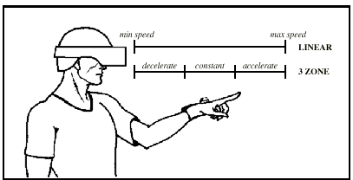
NAVIGATION
Navigation in VR system is the users' ability to move around and explore the virtual environment
Navigation in VR is dependent on what functionality you want to give to the users.
Navigation Techniques
Steering : direction and velocity
hand-directed
gaze-directed
physical devices
(steering wheel, flight sticks)
Target-based
point at object, list of coordinates
Route planning
place markers in world
24

Slide 24

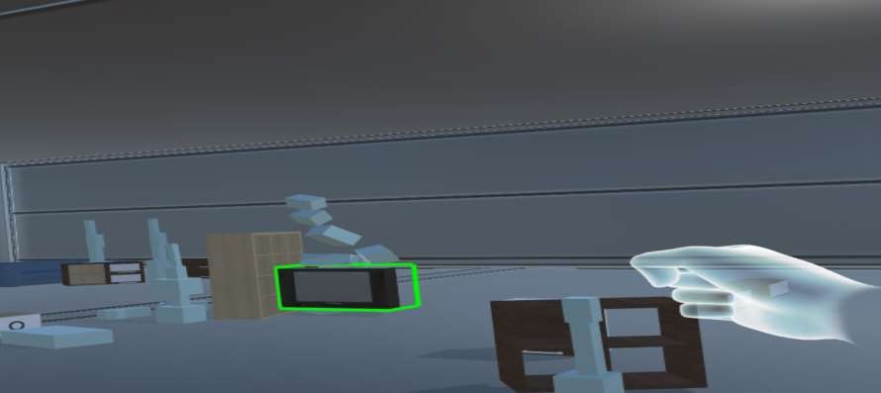
MANIPULATION
Direct Manipulation is the ability for a user in virtual reality to control objects in the virtual environment in a direct and natural way
Direct manipulation provides many advantages for the exploration of complex, multi-dimensional data sets, by allowing the investigator the ability to intuitively explore the data environment.
An investigator can, for example, move a “data probe” about in space, watching the results and getting a sense of how the data varies within its spatial volume.
25

Slide 25


MANIPULATION INTERFACE
When data probe is taken into account, the user is allowed to move the data probe anywhere in three- dimensional space, and in response to that movement several operations must occur:
Collision Detection: the system must identify that the user has “picked up” or “moved” the data probe.
Data Access: for a given spatial position of the data probe, the system must locate the data (vector data in our
example) for that location and access that data, as well as all data involved in the visualization computation.
Visualization Computation: The geometry of the visualization (the streamline in our example) must be computed.
Graphical Rendering: The entire graphical environment must be re-rendered from the viewpoint of the user’s
current head position.
26

Slide 26
GRAPHICS DISPLAY INTERFACES

Slide 27
Graphics Display Interfaces
Graphics Display is a computer interface that is designed to present synthetic world images to the users interacting with the virtual environment.
Virtual Reality: Output Devices

Slide 28
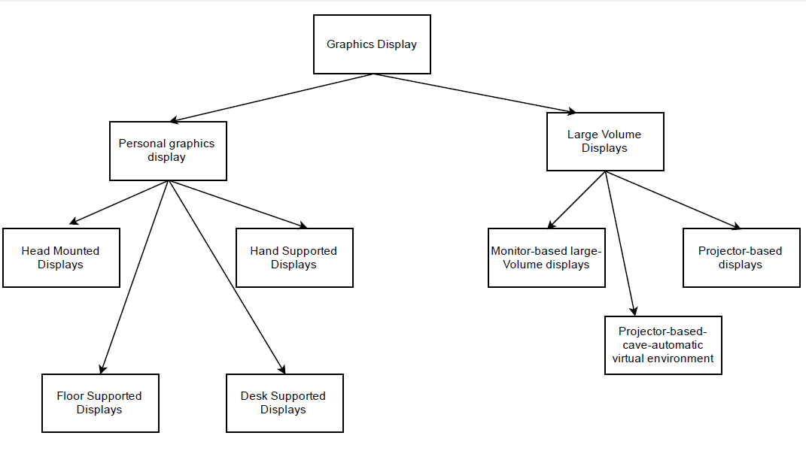
Virtual Reality: Output Devices

Slide 29
Personal Graphics Display
A graphics display that outputs a virtual scene destined to be viewed by a single user is called a personal graphics display.
Image produced may be :-
- Monocular (for a single eye).
- Binocular (displayed on both eye).
Virtual Reality: Output Devices

Slide 30
Head Mounted Display
HMD can focus at short distances.
It is a device worn on head or can be integrated as a part of the helmet ,with a small display optic in front of the eye.
It can either be monocular or binocular.
HMD’s are designed to ensure that no matter in what direction a user might look ,the monitor stays in front of the eyes.
The HMD screen can be either LCD or CRT.
LCD-HMD’s: used for consumer grade devices ,
LCD-CRT: used in more expensive professional based devices for VR interaction. Google glasses
Notes:
Although CRT displays are bulky and heavier ,they offer better screen resolution and brightness for HMD.
HMD mostly consist of a tracking device in the so that the point of view displayed in the monitors changes as the user moves his head.
Google glasses are also an example of HMD’s.
Google glass is an optical HMD ,shaped like a pair of eye glasses which allows the user to access information in the internet through voice commands, and display such information in a corner of the glass.
HMDs are not only used in virtual reality gaming, they’ve also been utilized in military, medical and engineering contexts to name a few.
Eg: Virtual library, Virtual training sessions, etc.

Slide 31
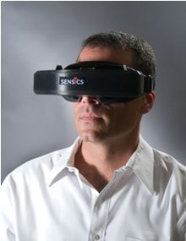
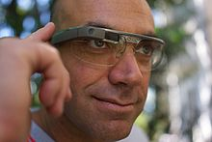
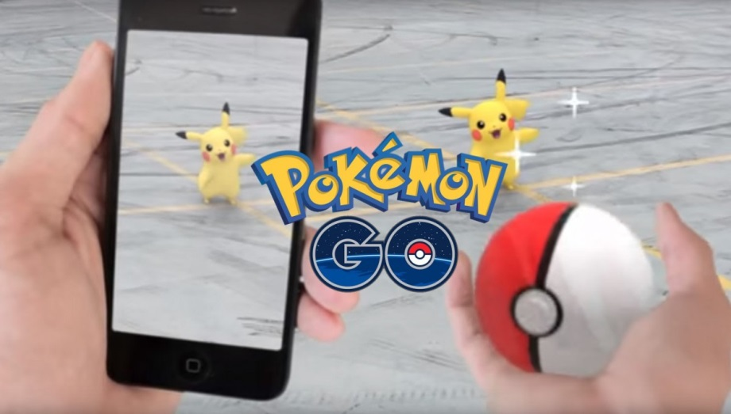
VIRTUAL REALITY
AUGMENTED REALITY

Slide 32
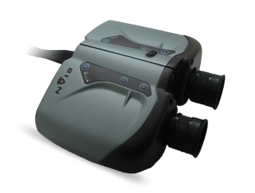
HAND SUPPORTED DISPLAYS
Here ,the user can hold the device in one or both hands in order to periodically view a synthetic scene.
This allows user to go in and out of the simulation environment as demanded by the application.
HSD’s have additional feature namely push buttons that can be used to interact with
the virtual scene.
Click for video:
Notes:
A virtual binocular measures the user’s viewing direction.
It allows variable distance focusing as well as zooming on the scene.
It is connected to a computer running on a serial line.
Virtual binoculars can be used by the soldiers
to see wheather any movement Is there in
enemy camps, specially borders.

Slide 33
Floor Supported Displays
These are alternatives to HMD’s and HSD’s in which an articulated mechanical arm is available to offload the weight of the graphics display from the user.
Do not require use of special glass, can be viewed with unaided eye.
Has 2 types:
Passive:
Active:
Notes:
Passive autostereoscopic displays- donot track user’s head ,this restricting user’s position.
Active autostereoscpic displays –tracks user’s head and gives the user more freedom of motion.

Slide 34
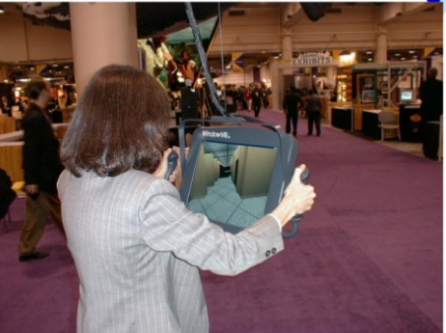
Click here for the video description:
Floor Supported Displays

Slide 35
Desk supported Displays
It overcomes the problems faced by users due to the excessive display weights in HMD’s and HSD’s.
Floor supported display also suffer from problem of oscillation due to excessive weight, Desk supported displays overcome these drawbacks.
These are fixed and designed to be used for viewing with user in sitting position.
Desk supported displays can be viewed with unaided eyes.

Slide 36
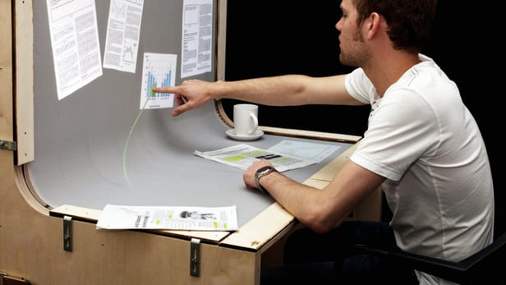
Desk supported Displays

Slide 37
Large Volume Displays
Large volume displays are used in VR environment that allow more than one user located in close proximity.
These allow the user with larger work envelope ,thus improving upon user’s freedom of motion and ability of natural interaction compared to personal displays.

Slide 38
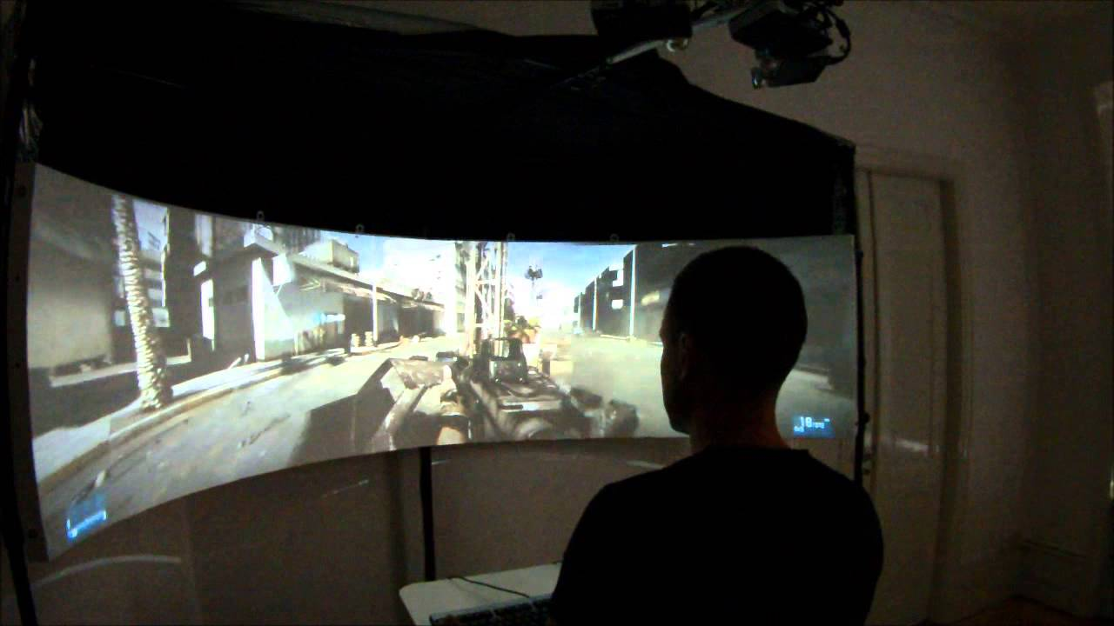
Large Volume Displays

Slide 39
Categorization based on type and size of display being used
Virtual Reality: Output Devices

Slide 40
Monitor-based Large Volume Display
This display relies on use of active glasses coupled with stereo-ready monitor.
The user of the system looks at the monitor through a set of shutter glasses.
The stereo ready monitor are capable of refreshing the screen at double of the normal scan rate.
The shutter glasses and the monitors are synchronized with each other.

Slide 41
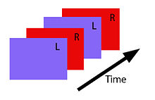
The active glasses are connected to an IR emitter located on top of the CRT display (connection is wireless).
The IR controller controls and signals liquid crystal shutters to close and occlude the eyes alternately.
The brain registers this rapid sequence of right and left eye images and fuses them to give the feeling of 3D.
Overview of the Shutter glasses here:-

Slide 42
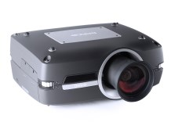
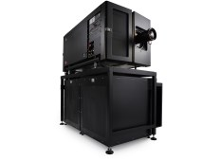
PROJECTOR-BASED DISPLAYS
Projector based displays have advantage of allowing group of closely located users to participate in a VR Simulation, on contrary to personal graphics displays.

Slide 43
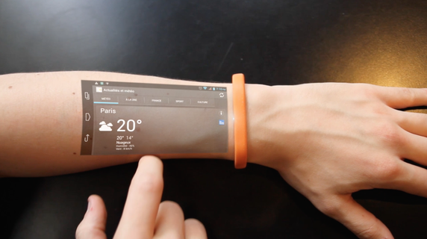
PROJECTOR-BASED DISPLAYS (Cicret Bracelet)

Slide 44
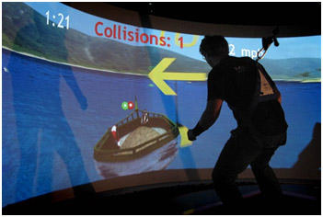
Cave-Automatic Virtual Environment(CAVE)

Slide 45
A CAVE is a projection-based VR display that uses tracked stereo glasses to feel the environment.
CAVE is basically a small room or cubicle where at least the 3 walls, sometimes the floor and the ceiling act as giant monitors.
The display gives the users a wide field of view ,something that most HMD’s cannot do.
User’s can also move around in the CAVE system.
Wearing tracked stereo glasses is a must
Virtual Reality: Output Devices

Slide 46
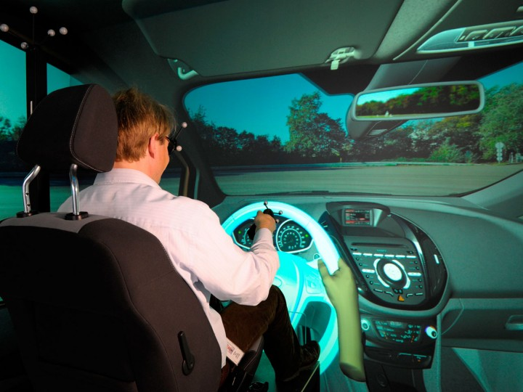
Tracking devices attached to the glasses tell the computer how to adjust the projected images as we walk around the environment.

Slide 47
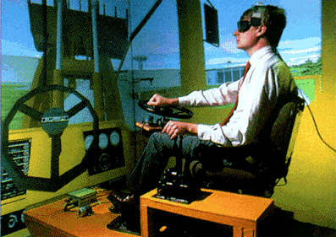
CAVE systems used in real world as driving simulators.

Slide 48
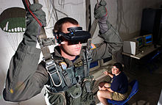
Training Simulator for the military forces

Slide 49
The sense of touch is also incorporated in the CAVE’s by using sensory gloves and other haptic devices. Some haptic devices also allow users to exert a touch or grasp or replace a virtual object.
The sound interacts with the brain three dimensionally enhancing the realism of the virtual environment experience.
Click to see the video on Large volume Displays:
Virtual Reality: Output Devices

Slide 50

VIRTUAL REALITY TECHNOLOGIES
UNREAL ENGINE
Unreal is a suite of tools for developers that can be used to create games and virtual reality environments. This is VIATechnik’s preferred tool for highly polished virtual reality experiences.

Slide 51
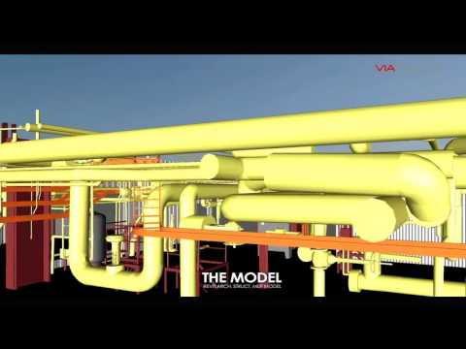
UNITY
Translating CAD or BIM models into virtual reality experiences used to take considerable time and programming know how. With the advent of the Unity gaming engine, bringing Revit/3D models into a virtual reality space becomes much easier. Now, any AEC professional can take their Revit model, bring it into Unity, and create a VR experience.

Slide 52
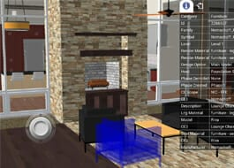
FUZOR
One thing that Fuzor does for AEC industry professionals is instantly transform Revit or Sketchup models into virtual reality experiences. This is a great tool for construction because greatly speeds up the process to get designs into VR – allowing users to iterate and improve on their designs.

Slide 53

TWIN MOTION
Twinmotion is a powerful and simple visualization engine that takes in various AEC models. Developed for architectural, construction, urban planning and landscaping professionals, regardless of the size and complexity of their project, their equipment, their computer skills or their modeler, Twinmotion is a simple to use tool powered by Unreal Engine that generates amazing graphics in a short amount of time.

Slide 54
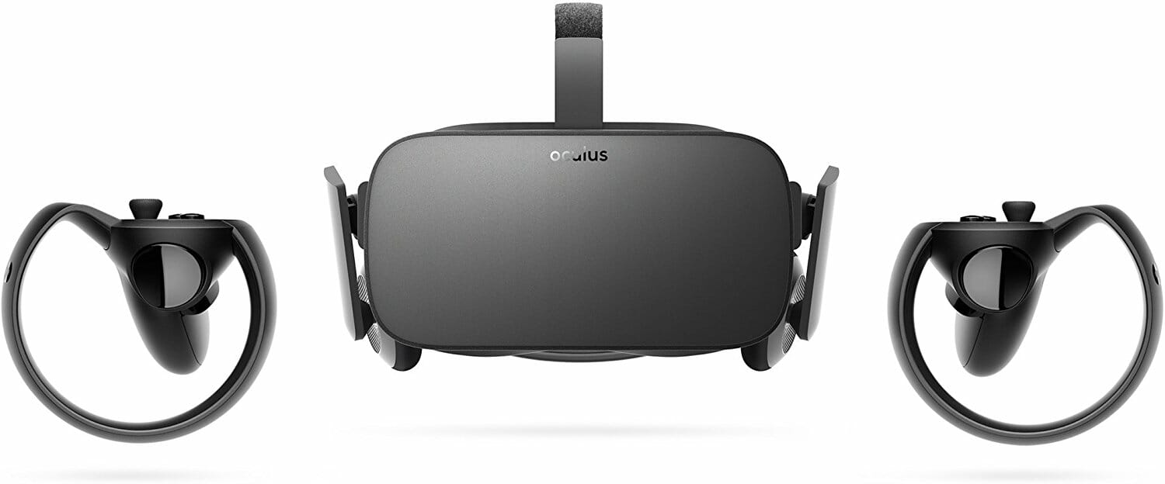
OCULUS RIFT
Oculus Rift’s headset is traditionally seen as a tool for gamers. However, in the AEC space, it makes working in virtual environments so much easier. Through the 3D experience combined with motion tracking capabilities, it becomes a lot easier to move around 3D models and look around corners than using a mouse and keyboard.

Slide 55
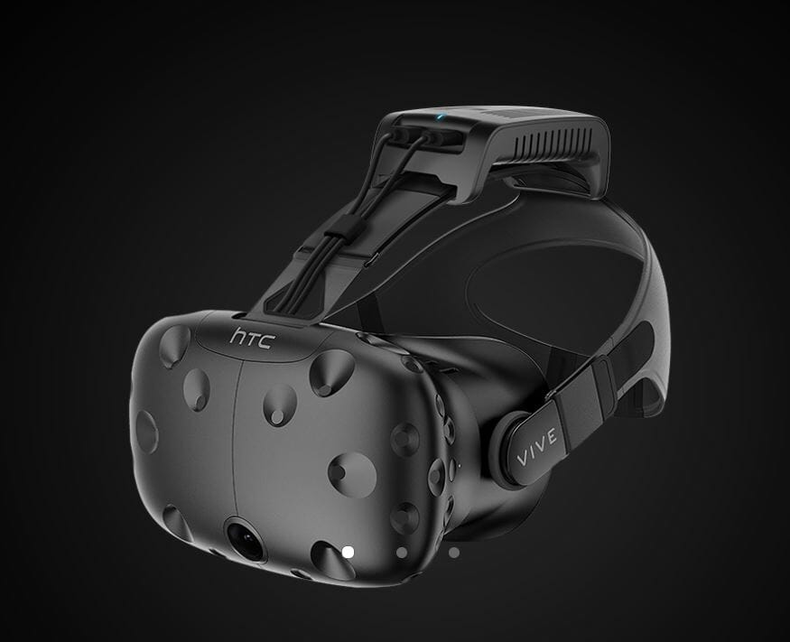
TP CAST
TPCast is an amazing tool that detethers the VR experience. Using an HD transmitter, one can experience a wireless VR experience through the HTC Vive. Imagine being able to run around a large VR environment without the risk of tripping over headset wires!

Slide 56

MAGIC LEAP
Translating CAD or BIM models into virtual reality experiences used to take considerable time and programming know how. With the advent of the Unity gaming engine, bringing Revit/3D models into a virtual reality space becomes much easier.

Slide 57
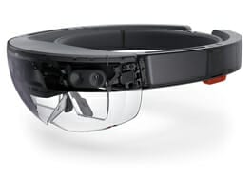
HOLOLENS
Microsoft’s Hololens is still in its development stage, but its conceptual release has already introduced various ways in which this technology can be applied to different industries. The Hololens utilizes augmented reality to create three dimensional objects within a real space (versus virtual reality, which focuses on a full virtual experience) through the use of light to create holographic images.

Slide 58
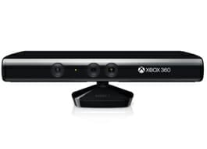
KINECT
The popular Kinect is a device that is part of the Xbox 360 and Xbox One Gaming consoles, but developers have pushed this technology onto other applications aside from gaming. The Kinect uses a RGB camera, depth sensor, and microphone to capture motion and sound within its depth of view. The advantage of the Kinect technology is its ability to not only recognize people and their gestures, but multiple people at the same time. The only limitation is how many people you can fit into its field of view without any obstructions.

Slide 59
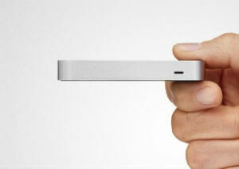
LEAP MOTION
The Leap Motion Controller is a motion-sensing device that allows users to see their hands in virtual reality and augmented reality. What’s more, the controller can be easily plugged into the USB ports of any Mac or PC. The technology converts hand and finger movements into 3D input with sub-millimeter accuracy, virtually no latency, and without gloves or other handheld accessories.

Slide 60
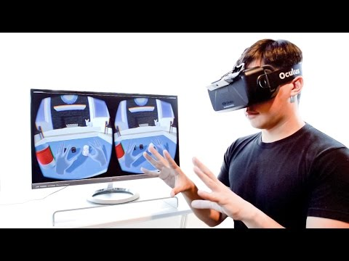
MYO
Myo is a wearable armband device that allows the user to use gestures to wirelessly control technology. Combining a set of EMG (electromyographic) sensors able to sense the electrical activity in the wearer’s forearm muscles, a gyroscope, an accelerometer, and a magnetometer, this device is able to read muscle activity, allowing the user to control software using gestures and motion. For instance, Myo allows you to easily navigate through slideshows by simply using gesture controls such as tapping fingers together, opening and closing the fist, or waving the hand. T

Slide 61
Tracking
Three categories of tracking may appear in VR systems, based on what is being trac
The user’s sense organs: the sense organs, such as eyes and ears, have DOFs that are controlled by the body.
If a display is attached to a sense organ, and it should be perceived as in VR as being attached to the surrounding world, then the position and orientation of the organ needs to be tracked.
The inverse of the tracked transformation is applied to the stimulus to correctly “undo” these DOFs.
Most of the focus is on head tracking, which is sufficient for visual and aural components of VR; however, the visual system may further require eye tracking if the rendering and display technology requires compensating for the eye movements.

Slide 62
The user’s other body parts: If the user would like to see a compelling representation of his body in the virtual world, then its motion should be tracked so that it can be reproduced in the matched zone.
Facial expressions or hand gestures are needed for interaction. Although perfect matching is ideal for tracking sense organs, it is not required for tracking other body parts.
Small movements in the real world could convert into larger virtual world motions so that the user exerts less energy.
In the limiting case, the user could simply press a button to change the body configuration. For example, she might grasp an object in her virtual hand by a single click.

Slide 63
The rest of the environment:
In the real world that surrounds the user, physical objects may be tracked. For objects that exist in the physical world but not the virtual world, the system might alert the user to their presence for safety reasons.
Imagine that the user is about to hit a wall, or trip over a toddler. In some VR applications, the tracked physical objects may be matched in VR so that the user receives touch feedback while interacting with them.
In other applications, such as telepresence, a large part of the physical world could be “brought into” the virtual world through live capture.

Slide 64
Tracking 2D Orientation
The main application is determining the viewpoint orientation, Reye
, while the user is wearing a VR headset. Another application is estimating the orientation of a hand-held controller
suppose we would like to make a laser pointer that works in the virtual world, based on a direction indicated by the user. The location of a bright red dot in the scene would be determined by the estimated orientation of a controller. More generally, the orientation of any human body part or moving object in the physical world can be determined if it has an attached IMU.

Slide 65
To estimate orientation, we first consider the 2D case by closely following the merry-go-round model
we mount a gyroscope on a spinning merry-go-round. Its job is to measure the angular velocity as the merry-go-round spins. It will be convenient throughout to distinguish a true parameter value from an estimate.

Slide 66
Calibration: If a better sensor is available, then the two can be closely paired so that the outputs of the worse sensor are transformed to behave as closely to the better sensor as possible.
Integration: The sensor provides measurements at discrete points in time, resulting in a sampling rate. The orientation is estimated by aggregating or integrating the measurements.
Registration: The initial orientation must somehow be determined, either by an additional sensor, or a clever default assumption or start-up procedure.

Slide 67
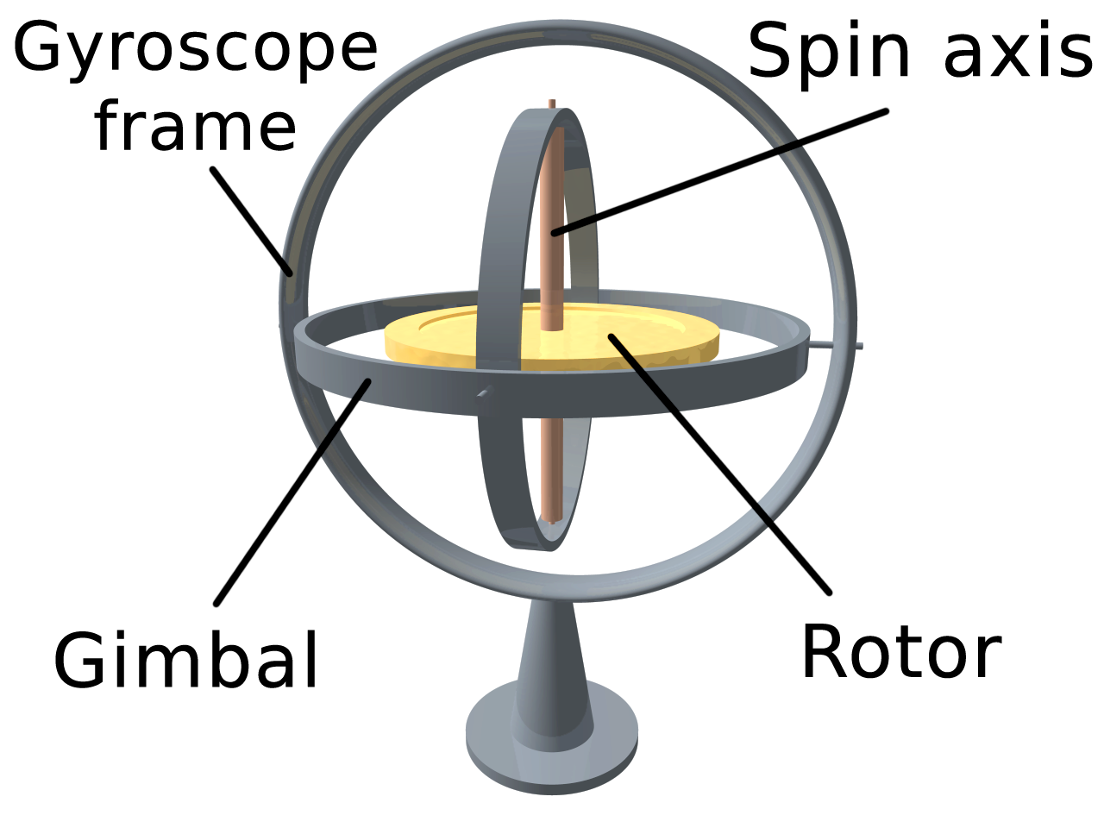
Drift error: As the error grows over time, other sensors are needed to directly estimate it and compensate for it.

Slide 68

Calibration
You could buy a sensor and start using it with the assumption that it is already well calibrated. For a cheaper sensor, however, the calibration is often unreliable. Suppose we have one expensive, well-calibrated sensor that reports angular velocities with very little error. Let ˆω ′ denote its output, to distinguish it from the forever unknown true value ω. Now suppose that we want to calibrate a bunch of cheap sensors so that they behave as closely as possible to the expensive sensor.
. A common criterion is the sum of squares error, which is given by X

Slide 69

Integration
Sensor outputs usually arrive at a regular sampling rate. For example, the Oculus Rift gyroscope provides a measurement every 1ms (yielding a 1000Hz sampling rate). Let ˆω[k] refer to the kth sample, which arrives at time k∆t.
The orientation θ(t) at time t = k∆t can be estimated by integration as:

Slide 70
Registration
The initial orientation θ(0) was assumed to be known. In practice, this corresponds to a registration problem, which is the initial alignment between the real and virtual worlds.
To understand the issue, suppose that θ represents direction for a VR headset.
One possibility is to assign θ(0) = 0, which corresponds to whichever direction the headset is facing when the tracking system is turned on.
This might be when the system is booted. If the headset has an “on head” sensor, then it could start when the user attaches the headset to his head.

Slide 71
Drift correction
To make a useful tracking system, the drift error cannot be allowed to accumulate. Even if the gyroscope were perfectly calibrated, drift error would nevertheless grow due to other factors such as quantized output values, sampling rate limitations, and unmodeled noise. The first problem is to estimate the drift error, which is usually accomplished with an additional sensor.

Slide 72

VR and Sense organs

Slide 73
TRACKING systems
The tracking systems are the main components for the VR systems.
They interact with the system’s processing unit.
This relays to the system the orientation of the user’s point of view.
In systems which let a user to roam around within a physical space, the locality of the person can be detected with the help of trackers, along with his direction and speed.

Slide 74

The various types of systems used for tracking utilized in VR systems.
• A six degree of freedom can be detected (6-DOF)
• Orientation consists of a yaw of an object, roll and pitch.
• These are nothing but the position of the objects within the x-y-z coordinates of a space, however, it is also the orientation of the object.

Slide 75
Electromagnetic tracking systems
– They calculate magnetic fields generated by bypassing an electric current simultaneously through 3 coiled wires.
These wires are set up in a perpendicular manner to one another. These small turns to be an electromagnet.
The system’s sensors calculate how its magnetic field creates an impact on the other coils.
The measurement shows the orientation and direction of the emitter.
The responsiveness of an efficient electromagnetic tracking system is really good. They level of latency is quite low.
The drawback is that whatever that can create a magnetic field, can come between the signals, which are sent to the sensors

Slide 76
Acoustic tracking systems
This tracking system senses and produces ultrasonic sound waves to identify the orientation and position of a target.
They calculate the time taken for the ultrasonic sound to travel to a sensor.
The sensors are usually kept stable in the environment.
The user puts on ultrasonic emitters. the calculation of the orientation as well as position of the target depending on the time on the time taken by the sound to hit the sensors is achieved by the system. Many faults are shown by the acoustic tracking system.
Sound passes by quite slowly, so the update’s rate on a target’s position is naturally slow.
The efficiency of the system can be affected by the environment as the sound’s speed through air often changes depending on the humidity, temperature or the barometric pressure sound in the environment

Slide 77
Optical tracking devices
– These devices use light to calculate a target’s orientation along with position.
The signal emitter typically includes a group of infrared LEDs. The sensors consist of nothing but only cameras.
These cameras can understand the infrared light that has been emitted.
The LEDs illuminates in a fashion known as sequential pulses.
The pulsed signals are recorded by the camera and then the information is sent to the processing unit of the system. Data can be extrapolated by this unit

Slide 78
Mechanical tracking systems
This tracking system is dependent on a physical link between a fixed reference point and the target.
One of the many examples is that mechanical tracking system located in the VR field, which is indeed a BOOM display.
A BOOM display, an HMD, is attached on the rear of a mechanical arm consisting 2 points of articulation.
The detection of the orientation and position of the system is done through the arm.
The rate of update is quite high with mechanical tracking systems, but the demerit is that they limit range of motion for a user.

Slide 79
MOTION TRACKING
Motion Tracking, the process of digitising your movements for use in computer software, is a key component of VR systems.
Being able to engage and interact with the virtual world the moment you step into a VR CAVE or put on your VR headset – without being reminded of the real world – is crucial to the creation of a truly immersive experience.

Slide 80

HOW DOES MOTION TRACKING WORK?
To understand how an object is able to move in three-dimensional space, we need to look at the concept of six degrees of freedom (6DoF), which refers to the freedom of movement of a rigid body in 3D space.

Slide 81
OPTICAL TRACKING
Optical tracking is where an imaging device is used to track body motion of an individual. The person who is being tracked is required to hold handheld controllers or an HMD (Head Mounted Display) that has the trackers on them or to wear optical markers, which are placed on certain parts of the body.

Slide 82
NON-OPTICAL TRACKING
Non-optical tracking makes use of microscopic electromechanical sensors that are installed in hardware or attached to the body to measure and track movements. These are typically gyroscopes, magnetometers, and accelerometers.

Slide 83


Slide 84
The hardware components of VR systems are conveniently classiﬁed as:
• Displays (output): Devices that each stimulate a sense organ.
• Sensors (input): Devices that extract information from the real world.
• Computers: Devices that process inputs and outputs sequentially.

Slide 85

DATA GLOVE
A data glove is an interactive device, resembling a glove worn on the hand, which facilitates tactile sensing and fine-motion control in robotics and virtual reality.
It is one of electromechanical devices used in haptics applications.
Tactile sensing involves simulation of the sense of human touch and includes the ability to perceive pressure, linear force, torque, temperature, and surface texture.
Fine-motion control involves the use of sensors to detect the movements of the user's hand and fingers, and the translation of these motions into signals that can be used by a virtual hand (for example, in gaming) or a robotic hand (for example, in remote-control surgery).

Slide 86
Body Tracking
Body tracking is the VR system's ability to sense position and actions of the participants.
The particular components of movement that are tracked depend on the body part and how the system is implemented.
tracking head movement might consist of just 3-DOF location, just 3-DOF orientation, or full 6-DOF position information.
tracking finger movement with a glove device, which might measure multiple joints of finger flexion or might measure just contacts between fingertips.
Any component of the body can be tracked in one or more degrees of freedom, assuming a suitable tracking mechanism is available in an appropriate size and weight and is attached to the system.

Slide 87
Tracking the head Tracking the hand and fingers
Tracking the eyes
Tracking the torso
Tracking the feet
Tracking other body parts
Indirect tracking

Slide 88
The Head
The head is tracked in almost every VR system, although not always the full 6-DOF.
VR systems need to know something about the user's head orientation and/or location to properly render and display the world.
location or orientation information is required depends on the type of display being used.
Head-based displays require head orientation to be tracked. As users rotate their heads, the scenery must adapt and be appropriately rendered in accordance with the direction of view, or the users will not be physically immersed.
Location tracking helps provide the sense of motion parallax (the sense that an object has changed position based on being viewed from a different point). This cue is very important for objects that are near the viewer.

Slide 89
The Hand and Fingers
Tracking the hand, with or without tracking the fingers, is generally done to give the user a method of interacting with the world .
In multiparticipant spaces, hand gestures provide communication between participants.
A hand can be tracked by attaching a tracker unit near the wrist or through the use of a tracked handheld device. I
if detailed information about the shape and movement of the hand is needed, a glove input device is used to track the positions of the user's fingers and other flexions of the hand.
The hand position tracker is generally mounted directly on the glove. While glove input devices provide a great amount of information about a key interactive part of the user's body, they have a few disadvantages.

Slide 90
The Eyes
Technology for tracking the direction in which the user's eyes are looking relative to their head has only recently become practical for use with virtual reality and, consequently, has not been tried in many applications.
One is monitoring the direction of the gaze to allocate computer resources.
The scene displays a higher degree of detail in the directon of the tracked eye's gaze.
Objects might be selected or moved based on the movement of the eyes.

Slide 91
The Torso
Very few VR applications actually track the torso of the participant, although when an avatar of the user is displayed, it often includes a torso with certain assumptions made about its position, based on head and hand positions.
The torso is actually a better indicator of the direction the body is facing than are either the head or hands.
The torso's bearing might be a better element to base navigational direction on than head or hand .
The benefit of using the torso's bearing for travel direction correlates with the user's experience level in moving through an immersive virtual world.

Slide 92
The Feet
Some work has been done to provide a means for tracking the feet of the user.
Tracking the feet provides an obvious means of determining the speed and direction a user wishes to travel.
The obvious method of determining feet movement is to track the position of each foot.
The most common way to do this is to use electromagnetic trackers. The tracker is attached to the foot with a wire connecting that device to the computer or to a body pack (containing a radio transmitter).
Optical tracking is another method and uses cameras to "watch" the feet. This doesn't require any sensors on the foot or attached wires. Tracking the feet this way, though, is tricky.
You would most likely want to put a very high-contrast spot or sticker on the foot to give the camera a very specific reference for which to "look.”

Slide 93
Indirect Tracking
Indirect tracking refers to the use of physical objects other than body parts to estimate the position of the participant.
These physical objects are usually props and platforms.
the movement of a hand- held device, such as a wand or a steering wheel mounted on a platform, are good indicators of the position of one of the participant's hands.

Slide 94
Sensors:
Magnetometers,
Accelerometers and
Gyroscopes

Slide 95
A magnetometer
is, as you probably can tell, a device that measures magnetic fields.
It act as a compass, by detecting magnetic North it can always tell which direction it is facing on the surface of the earth.
Clever developers have repurposed the magnetometer for use with the Google Cardboard, where a magnetic ring is slid up and down another magnet, the fluctuation in the field is then registered as a button click.
Metal detectors also use magnetometers, which is why they can only detect ferrous metals.

Slide 96
An accelerometer
is a mechanism that lets your device, such as a smartphone, know which way up it is.
This is the sensor that tells your phone or tablet whether the screen should be in portrait or landscape mode.
One accelerometer can tell whether it is in line with the pull of gravity or not, but if you combines three of them (one for each axis) you can tell which way up something is, since each axis is fixed in relation to the device it is in.
accelerometers can measure more than orientation. As the name suggests it can also measure the magnitude of acceleration along an axis.
they are used to trigger airbags during a crash where the g-force along the horizontal axis exceeds a certain threshold.

Slide 97
Gyroscopes
No matter how the frame (and whatever it’s mounted to) changes orientation, the spinning disc in the middle stays true to its original plane.
aircraft where you may not know if the craft is level or not due to issues like visibility can be detected by MEMS(Micro-Electro-Mechanical Systems)
The types of components used to measure rotation in electronic devices can be quite varied.
Generally they detect vibration that’s translated to rotational measurement with microscopic tuning forks, vibrating wheels or resonant solid matter.
These work like the organs of insects (known as halteres) that help to orient them .
These MEMS gyroscopes are also known as vibrating structure gyroscopes. Since objects that vibrate tend to continue vibrating in the same plane even when rotated, which means the vibrating mass generates a coriolis force that can be detected electronically.

Slide 98
Motion capture
(sometimes referred as mo-cap or mocap, for short) is the process of recording the movement of objects or people. It is used in military, entertainment, sports, medical applications, and for validation of computer vision and robotics. In filmmaking and video game development,
it refers to recording actions of human actors, and using that information to animate digital character models in 2D or 3D computer animation.
When it includes face and fingers or captures subtle expressions, it is often referred to as performance capture. In many fields, motion capture is sometimes called motion tracking, but in filmmaking and games, motion tracking usually refers more to match moving.

Slide 99
Optical systems
Optical systems
Optical systems utilize data captured from image sensors to triangulate the 3D position of a subject between two or more cameras calibrated to provide overlapping projections.
Data acquisition is traditionally implemented using special markers attached to an actor; however, more recent systems are able to generate accurate data by tracking surface features identified dynamically for each particular subject.
Tracking a large number of performers or expanding the capture area is accomplished by the addition of more cameras.
These systems produce data with three degrees of freedom for each marker, and rotational information must be inferred from the relative orientation of three or more markers;
for instance shoulder, elbow and wrist markers providing the angle of the elbow.

Slide 100

Passive markers
Passive optical systems use markers coated with a retroreflective material to reflect light that is generated near the cameras lens. The camera's threshold can be adjusted so only the bright reflective markers will be sampled, ignoring skin and fabric.
The centroid of the marker is estimated as a position within the two-dimensional image that is captured.
An object with markers attached at known positions is used to calibrate the cameras and obtain their positions and the lens distortion of each camera is measured.
If two calibrated cameras see a marker, a three-dimensional fix can be obtained.

Slide 101
Active marker
Active optical systems triangulate positions by illuminating one LED at a time very quickly or multiple LEDs with software to identify them by their relative positions,
Rather than reflecting light back that is generated externally, the markers themselves are powered to emit their own light

Slide 102
Video based input
Virtual reality (VR) is an exciting new medium with broad applications in entertainment, marketing, design, and more.
Every bit as flexible and dynamic are the professionals who specialize in creating and adapting content for virtual reality.
VR content creators use two main methods to create VR content: computer-generation, wherein every part of the world is synthetic, designed and integrated into an interactive experience using code; and 360-degree video, where video is taken using an omnidirectional camera and edited to create an immersive experience

Slide 103
360-Degree Immersive Video
video is shot using an omnidirectional camera, spliced together using special video stitching software, and edited further in order to be optimized for viewing on a head-mounted display (HMD).
content creators will fill more than one role on a single project, but VR content creators who work in this medium can take on a number of jobs, including:
direction—conceiving and leading the project;
filming—setting up tripods, guiding the Steadicam, or piloting a drone-mounted camera;
audio capture—setting up sitting directly beneath the tripod; and postproduction.

Slide 104
Interactive 3D Development
The "virtual" in virtual reality is why most people tend to picture this kind of content when they think of putting on a VR headset.
creating video-based VR content is like making a film, then creating interactive VR content is like developing a video game.
Creators use 3D game development software—called "engines"—to build entire worlds from the ground up. This often means creating original 3D models and animations with software such as 3DS Max or Maya; using applications such as Photoshop or Zbrush to add color and texture;
using the engine's built-in tools to add lighting to the scene; and designing original sound effects to bring the visual content to life.
interactive VR content creators write code—using the advanced functionality provided by the game engine—to tie everything together.

Slide 105
Menus

